Slide 1
Welcome to our
Information Session
Grade 9 and 10 - Enriched
Wednesday Sept. 13, 2023

Slide 2
Welcome from our Principal
Ms. Navaratnasingham

Slide 3
Information Session Presenter
IB DP Coordinators
Stephanie Silliker
Saint John Paul II CSS
685 Military Trail
Scarborough ON
M1E 4P6
Canada
(416) 393-5531
stephanie.silliker@tcdsb.org
Suzanne Regimbal
Saint John Paul II CSS
685 Military Trail
Scarborough ON
M1E 4P6
Canada
(416) 393-5531
suzanne.regimbal@tcdsb.org
Note: a PDF of this presentation will be available on our IB website

Slide 4
Agenda
Land Acknowledgement and Prayer
Introductions
IB Mission Statement
Alumnus Recap
Fees
Opportunity for Questions

Slide 5
Land Acknowledgement

Slide 6
Prayer for a new beginning
Please say this with us.

Slide 7
Visit our IB website for more details! Please Note - Currently under Construction

Slide 8
IB Mission Statement
The International Baccalaureate® aims to develop inquiring, knowledgeable and caring young people who help to create a better and more peaceful world through intercultural understanding and respect.
To this end the organization works with schools, governments and international organizations to develop challenging programmes of international education and rigorous assessment.
These programmes encourage students across the world to become active, compassionate and lifelong learners who understand that other people, with their differences, can also be right.
www.ibo.org

Slide 9
What happens in Grade 9 and 10?
Students will enter a two year junior preparatory program designed to introduce them to the IB and to prepare them for academic success. It is a stepping stone to IB.

Slide 10
JP is designed to:
Give students a chance to “test the IB waters” and see if IB is the right fit for them

Slide 11
2. Focus on the learning skills and study habits that will help students be successful in their learning

Slide 12
What does JP look like in Grade 9?
You will take enriched classes in:

Slide 13
Please note:
Following this Grade 9 cohort, Grade 9 classes beginning in September 2024 will now be “destreamed” according to the Ministry of Education’s new equity policies.

Slide 14
What does JP look like in Grade 10?
You will continue to take enriched classes in:

Slide 15
And you will take enrichment in
History
Religion
(as a preparation for Theory of Knowledge)

Slide 16
Students “fast track” math in Grade 10
•Semester 1 – MPM 2DE (grade 10)
•Semester 2 – MCR 3U4 (grade 11)
WHY???
•to mirror other IB schools in Ontario
•to ensure all IB students meet OSSD and University Math Requirements
• to cover all required IB curriculum in the time allocated

Slide 17
What are my choices after taking the Grade 9 and 10 Enriched Programme?
•IB Diploma Programme
OR
•Academic Stream or College Stream

Slide 18
Why do IB?
99% of Universities world wide recognize IB
In Canada – early admission, transfer credits, entrance scholarships
40% of students exit university after first year; only 15 % of IB students exit after their first year

Slide 19
The IB Toolkit
Universities want the whole package IB provides you with! – you leave with a set of tools that increase your chances of success
•Communication skills
•Research skills
•Confidence
•Ability to balance academics with extra curriculars
•Examanship
•Time Management
•Subject Specific Skills

Slide 20
Our graduates have ...
Earned prestigious National and Provincial Scholarships such as the Loran and Schulich Scholarships
Earned prestigious Chancellors and President’s Awards at most universities in Ontario including Ryerson, University of Toronto, Ottawa, McMaster, and University of Waterloo
Been accepted to universities all over Ontario, Canada, the US and Europe

Slide 21
Our students have been accepted to:
•University of Toronto
•York University – Schulich School of Business
•Queen’s University
•University of Ottawa
•University of Waterloo
•Carleton University
•McMaster University
•Western University’
•TMU University

Slide 22
Brock University
•Trent University
•University of Guelph
•Wilfrid Laurier University
•OCAD
•University of Ontario Institute of Technology
•University of Windsor
•University of British Columbia
•McGill University
•University of Manitoba
•Dalhousie University

Slide 23
•Niagara University (New York, USA)
•Ohio Dominican University (Ohio, USA)
•Richmond International University (London, England)
•Capernwray Bible College (Bodenseehof, Germany)
•St. Andrews (Scotland)
•London School of Economics (London, England)
•Smith College (Massachusetts, USA)
•University of Geneva (Geneva, Switzerland)
•Hull University (York, England)
•Nova Southeastern University (Florida, USA)
•Mississippi Valley State University (Mississippi, USA)
•University of Incarnate Word of Texas (Texas, USA)

Slide 24
Meet some of our IB Graduates!

Slide 25
VALENTINA SHAMOUN 2021
$10,000 scholarship from the Boys and Girls Club Canada

Slide 26
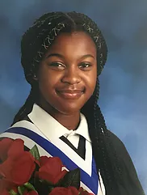
AMEN OKUNGBOWA 2020
SCHULICH LEADERSHIP SCHOLARSHIP WINNER
2020
one of 60 students selected from across Canada
$60,000

Slide 27
MICHELLE HOANG 2018
NOVA SOUTHEASTERN UNIVERSITY
2018
President’s Scholarship to study Dentistry
$25,000 USD/yr renewable

Slide 28
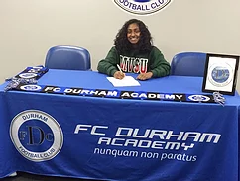
REMEYA GANESH 2017
MISSISSIPPI VALLEY STATE UNIVERSITY
2017
Athletic and Academic Scholarship combined
$100,000 USD over 4 years

Slide 29
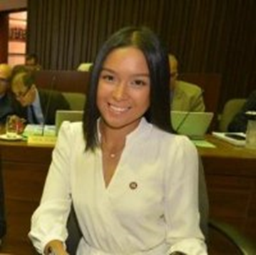
ALLISON GACAD 2016
LORAN NATIONAL SCHOLARSHIP WINNER
One of 30 National scholars across Canada 2016
$100,000 scholarship award winner
Student Trustee, TCDSB 2015-2016
Co-created Student Leadership Conference 2016, “Release the East”
Studying Environmental Sciences

Slide 30
A NOTE ABOUT IB FEES
The TCDSB have the LOWEST IB fees in Toronto
Grade 11 fees $400 ($200 Deposit in Grade 10 in June 2024 (non-refundable) and $200 in October 2024)
Grade 12 fees $700 (Oct. 2025 - subject to change)
BRANKSOME HALL $38,000 / yr
UPPER CANADA COLLEGE $37, 000 / yr
YORK SCHOOL $33,000 / yr

Slide 31
Do you have any questions?

