Slide 1
Welcome to our
Information Session
Grade 11 and 12 IB
Wednesday Sept. 13, 2023

Slide 2
Welcome from our Principal
Ms. Navaratnasingham

Slide 3
Information - Session Presenters
IB DP Coordinators
Stephanie Silliker
Saint John Paul II CSS
685 Military Trail
Scarborough ON
M1E 4P6
Canada
(416) 393-5531
stephanie.silliker@tcdsb.org
Suzanne Regimbal
Saint John Paul II CSS
685 Military Trail
Scarborough ON
M1E 4P6
Canada
(416) 393-5531
suzanne.regimbal@tcdsb.org
Note: a PDF of this presentation will be available on our IB website

Slide 4
Agenda
Land Acknowledgement and Prayer
IB Mission Statement
Alumnus Recap
Fees
Major Deadlines /Assessments
Exam Schedule May 2024
Opportunity for Questions

Slide 5
Land Acknowledgement
Out of our deep respect for Indigenous peoples in Canada, we acknowledge that all Toronto Catholic District School Board properties are situated upon traditional territories. The territories include the Wendat, the Anishinabek (a-ni-shna-bek) Nation, the Haudenosaunee (hoh-Dee-noh-Shoh-nee) Confederacy, and the Mississaugas of the Credit First Nations. We also recognize the contributions and enduring presence of all First Nations, Métis, and Inuit people in Ontario and the rest of Canada.

Slide 6
Prayer for a new beginning
Please say this with us.

Slide 7
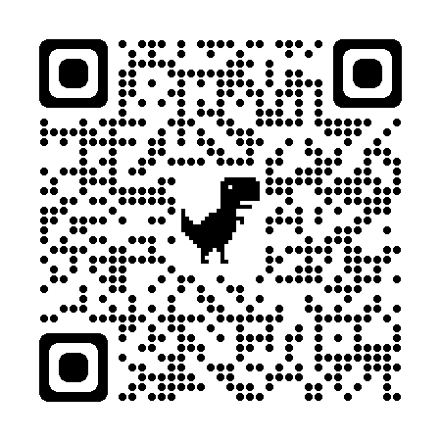
Visit our IB website for more details! Please Note - Currently under Construction

Slide 8
IB Mission Statement
The International Baccalaureate® aims to develop inquiring, knowledgeable and caring young people who help to create a better and more peaceful world through intercultural understanding and respect.
To this end the organization works with schools, governments and international organizations to develop challenging programmes of international education and rigorous assessment.
These programmes encourage students across the world to become active, compassionate and lifelong learners who understand that other people, with their differences, can also be right.
www.ibo.org

Slide 9
Our graduates have ...
Earned prestigious National and Provincial Scholarships such as the Loran and Schulich Scholarships
Earned prestigious Chancellors and President’s Awards at most universities in Ontario including TMU, University of Toronto, Ottawa, McMaster, and University of Waterloo
Been accepted to universities all over Ontario, Canada, the US and Europe

Slide 10
Our students have been accepted to:
•University of Toronto
•York University – Schulich School of Business
•Queen’s University
•University of Ottawa
•University of Waterloo
•Carleton University
•McMaster University
•Western University’
•TMU University

Slide 11
Brock University
•Trent University
•University of Guelph
•Wilfrid Laurier University
•OCAD
•University of Ontario Institute of Technology
•University of Windsor
•University of British Columbia
•McGill University
•University of Manitoba
•Dalhousie University

Slide 12
•Niagara University (New York, USA)
•Ohio Dominican University (Ohio, USA)
•Richmond International University (London, England)
•Capernwray Bible College (Bodenseehof, Germany)
•St. Andrews (Scotland)
•London School of Economics (London, England)
•Smith College (Massachusetts, USA)
•University of Geneva (Geneva, Switzerland)
•Hull University (York, England)
•Nova Southeastern University (Florida, USA)
•Mississippi Valley State University (Mississippi, USA)
•University of Incarnate Word of Texas (Texas, USA)

Slide 13
Meet some of our IB Graduates!

Slide 14
VALENTINA SHAMOUN 2021
$10,000 scholarship from the Boys and Girls Club Canada

Slide 15
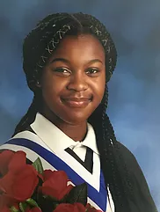
AMEN OKUNGBOWA 2020
SCHULICH LEADERSHIP SCHOLARSHIP WINNER
2020
one of 60 students selected from across Canada
$60,000

Slide 16
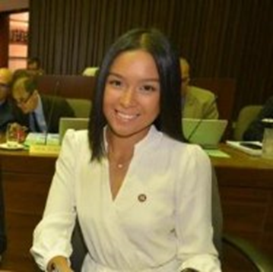
ALLISON GACAD 2016
LORAN NATIONAL SCHOLARSHIP WINNER
One of 30 National scholars across Canada 2016
$100,000 scholarship award winner
Student Trustee, TCDSB 2015-2016
Co-created Student Leadership Conference 2016, “Release the East”
Studying Environmental Sciences

Slide 17
A NOTE ABOUT IB FEES
The TCDSB has the LOWEST IB fees in Toronto
Grade 11 fees: $400
$200 (non-refundable) Deposit was made in Grade 10 - June 2023
$200 Deposit by Oct. 31, 2023
Grade 12 fees: $700
$700 due October 31, 2023 in order to be registered for May 2024 exams
All financial concerns need to be reviewed with Admin Team
BRANKSOME HALL $38,000 / yr
UPPER CANADA COLLEGE $37, 000 / yr
YORK SCHOOL $33,000 / yr

Slide 18
FEES - Grade 11 IB
Reminder that Grade 11 IB fees are due Oct. 31, 2023. School Cash Online will be set up in September - We will post on ManageBac when it is ready to accept payments.
Grade 11 IB Diploma Students $400 *note: $200 - non-refundable deposit was made in Grade 10 - June 2023

Slide 19
FEES - Grade 12 IB
Reminder that Grade 12 IB fees are due Oct. 31, 2023.
School Cash Online will be set up in September - I will post on ManageBac when it is ready to accept payments.
IB Diploma Students $700
Any students completing certificates - PLEASE SEE MS. WALLNER IN THE MAIN OFFICE ASAP TO WORK OUT YOUR FEES BASED ON YOUR BUNDLE.

Slide 20
Grade 11 Major Assessments
IB CORE COMPONENTS:
EE
Extended Essay introduction Oct. 10, 2023 @ 2:30 p.m.
Extended Essay Mandatory After-School class - Mon. Oct. 16 to Mon. Nov. 27, 2023. Followed by a second session in Sem. 2 - Mon. Feb. 5 to Mon. April 15, 2024. Both sessions will run every Monday after school until 4 p.m.
CAS - Creativity, Activity and Service Hours
Roughly 17 months to complete until January 2025
Intro during Lunch and Learn (Oct. 3 Lunch 1) in the Learning Commons for the IB Core
TOK - Theory of Knowledge
Builds on HRE 20E course
French Exams
May 2024

Slide 21
Grade 12 Major Assessments
IB CORE COMPONENTS:
EE - Extended Essay due September 29th (No exceptions)
CAS - Creativity, Activity and Service Hours - Due January 2024
Interim Predicted grades - Wed. Feb. 7, 2024
Predicted grades - Mon. April 8, 2024
Final Exams - May 2024

Slide 22
May 2024 Exam Schedule
Final IB Exams run from Wed. May 1 to Friday May 17, 2024
Exam prep sessions will be given in second semester
Check ManageBac for the exam schedule and the IB SJPII Website

Slide 23
Managebac - Our Communication Tool for all important assessments/deadlines

Slide 24
Do you have any questions?

